Slide 1

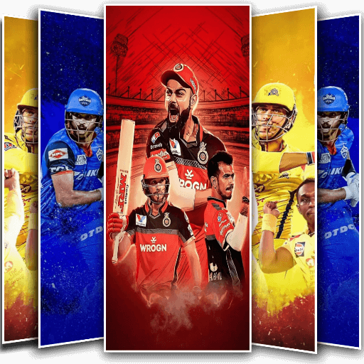



CRICKET TOURNAMENT ANALYSIS
VAIBHAV KUMAR

Slide 2
PROJECT SCENARIO
The Indian Premier League (IPL) has become one of the most popular and competitive cricket leagues in the world, showcasing the talents of both domestic and international players. As the excitement builds up for the IPL 2023 season, this project aims to identify and select the best 11 players who can form an unbeatable team.

Slide 3
PROJECT GOALS
Form a cricket team capable of scoring an average of 170 runs per inning.
Form two cricket teams capable of defending an average of 140 runs per inning.
Ensure balanced team composition with players skilled in batting, bowling, and fielding.
Consider individual player statistics, teamwork, and strategic planning for team selection.
Optimize team selection to maximize performance and achieve consistent results.
[Note - While selecting the team we have to keep in mind that at least 1 Wicket Keeper should be there.]

Slide 4
PLAYER SELECTION CRITERIA
OPENER
Batting Average | Average runs scored in an inning | >40
Strike Rate | No. of runs scored per 100 balls | >140
Innings Batted | Total innings batted | >5
Boundary % | % of runs scored in boundary | >50
Batting Position | Position at which the batter played | <3
Parameters
Description
Criteria

Slide 5
PLAYER SELECTION CRITERIA
MIDDLE-ORDER
Batting Average | Average runs scored in an inning | >35
Strike Rate | No. of runs scored per 100 balls | >135
Innings Batted | Total innings batted | >5
Boundary % | % of runs scored in boundary | >35
Batting Position | Position at which the batter played | >2 & <6
Parameters
Description
Criteria

Slide 6
PLAYER SELECTION CRITERIA
FINISHER
Batting Average | Average runs scored in an inning | >25
Strike Rate | No. of runs scored per 100 balls | >140
Innings Batted | Total innings batted | >5
Boundary % | % of runs scored in boundary | >60
Batting Position | Position at which the batter played | >4 & <=7
Average Balls Faced | Average balls faced by the batter in an inning | >10
Parameters
Description
Criteria

Slide 7
PLAYER SELECTION CRITERIA
ALL-AROUNDER
Batting Average | Average runs scored in an inning | >15
Strike Rate | No. of runs scored per 100 balls | >140
Innings Batted | Total innings batted | >4
Innings Bowled | Total innings bowled | >5
Bowling Economy | Average runs allowed per over | <8.5
Bowling Strike Rate | Average no. of balls required to take a wicket | <20
Parameters
Description
Criteria

Slide 8
PLAYER SELECTION CRITERIA
FAST & MEDIUM BOWLER
Bowling Average | No. of runs allowed per wicket | <20
Dot Ball % | % of dot balls bowled | >30
Bowling Style | Bowling style of player | = “%Fast%” or “%Medium”
Innings Bowled | Total innings bowled | >6
Bowling Economy | Average runs allowed per over | <8.5
Bowling Strike Rate | Average no. of balls required to take a wicket | <16
Parameters
Description
Criteria

Slide 9
DATA COLLECTION & DATA CLEANING PROCESS
The data was collected using the web scraping technique with the help of a tool known as ParseHub.
Data Source - ESPN website
Then the raw data was exported to jupyter notebook and cleaned with the help of Pandas and Numpy library. Finally, the cleaned CSV file was exported. Some further Excel formulas were used then to determine the player's batting order.

Slide 10
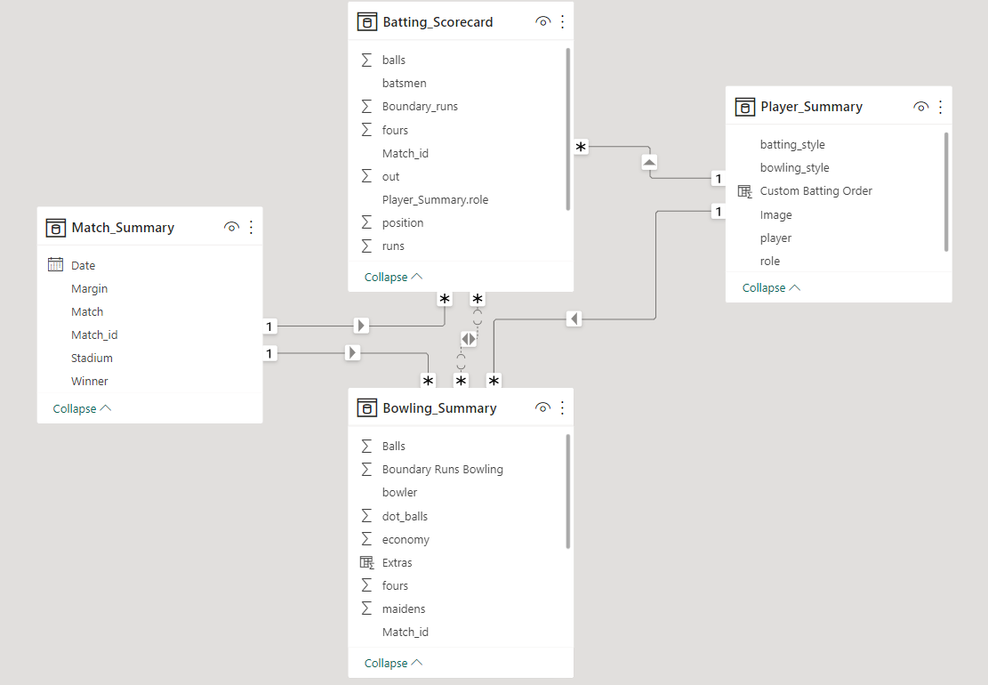
DATA MODELLING
The cleaned data was imported to PowerBi and some calculations were done in power query to make it ready for visualization, and then the data modeling was done using the primary keys to connect the tables.

Slide 11
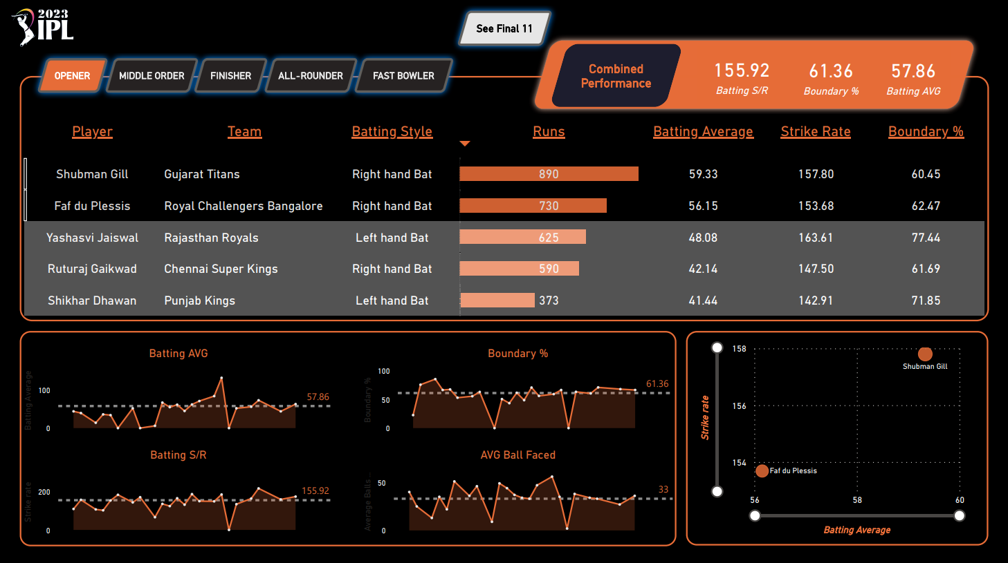
DASHBOARD

Slide 12
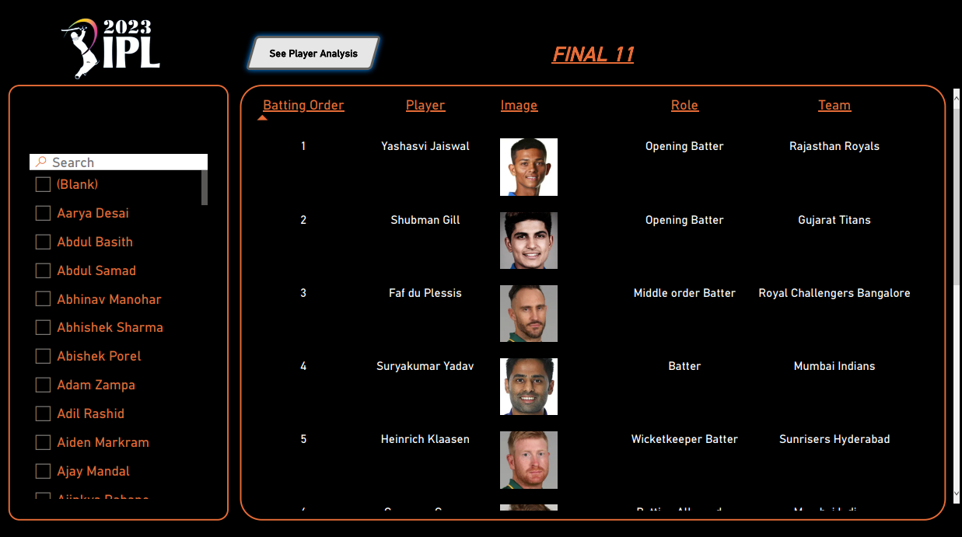
CRicket Tournament Analysis
CRicket Tournament Analysis
DASHBOARD

Slide 13
RESULTS
Using the dashboard I formed a cricket team that can consistently score an average of 170 runs per inning. The team composition is well-balanced, comprising players who excel in batting, bowling, and fielding. Each player's individual statistics were carefully considered, and strategic planning was employed during team selection. Notably, we ensured the presence of at least one skilled wicketkeeper. Through our optimized team selection, we have achieved exceptional performance and consistently achieved our target score.
Complete Folder For The Project - LINK

Slide 14
Thank
you

